Slide 1
Calculus Lesson Plan Objectives

Slide 2
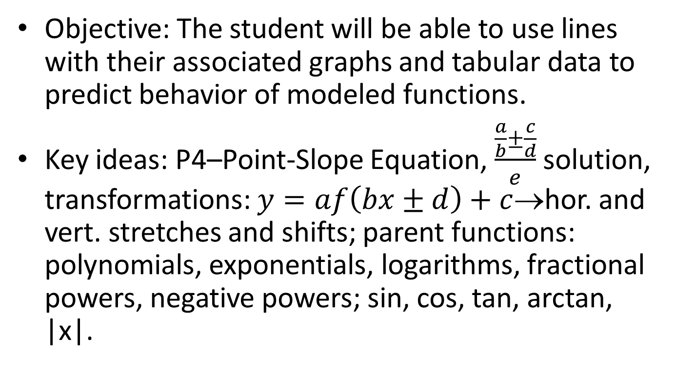
Prerequisites– Lines [Unit 1.1]
Objective: The student will be able to use lines with their associated graphs and tabular data to predict behavior of modeled functions.
Key ideas: P4–Point-Slope Equation, $\frac{\frac{a}{b}±\frac{c}{d}}{e}$ solution, transformations: $y=af\left(bx±d\right)+c$→hor. and vert. stretches and shifts; parent functions: polynomials, exponentials, logarithms, fractional powers, negative powers; sin, cos, tan, arctan, |x|.

Slide 3
Prerequisites– Analysis of Functions, Graphs, and Limits [Units 1.2-1.6]
Objective: The student will be able to predict and explain local and global behaviors of continuous and piece-wise functions; with a special emphasis on exponential, logarithmic, trigomometric and inverse functions.

Slide 4
Limits of Functions (including one-sided limits) [Unit 2.1]
Objective: The student will have an intuitive understanding of the limiting process; the ability to calculate limits using algebra, and will be able to estimate limits from graphs or tables of data.
Key ideas: P61–Properties of Limits; P64–1 sided Limits; P65–Sandwich Theorem; 1st reason limits DNE: limit– ≠ limit⁺.

Slide 5
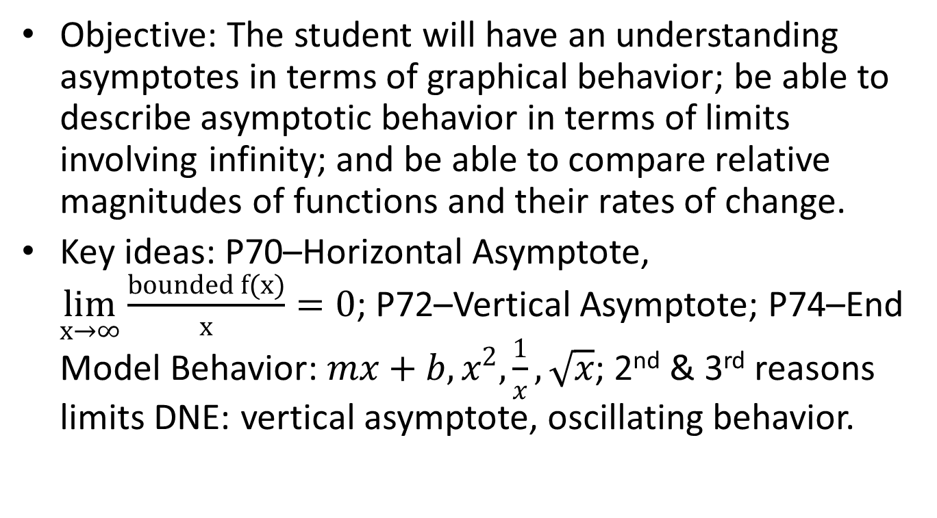
Asymptotic and Unbounded Behavior [Unit 2.2]
Objective: The student will have an understanding asymptotes in terms of graphical behavior; be able to describe asymptotic behavior in terms of limits involving infinity; and be able to compare relative magnitudes of functions and their rates of change.
Key ideas: P70–Horizontal Asymptote, $\lim_{x→∞}{\frac{bounded f(x)}{x}=0}$; P72–Vertical Asymptote; P74–End Model Behavior: $mx+b, x^{2}, \frac{1}{x}, \sqrt{x}$; 2nd & 3rd reasons limits DNE: vertical asymptote, oscillating behavior.

Slide 6
Continuity as a Property of Functions [Unit 2.3]
Objective: The student will have an intuitive understanding of continuity in terms of limits; geometric understanding of graphs of continuous functions; and be able to apply the Intermediate Value Theorem to appropriate functions.
Key ideas: P79–Continuity at a point; P83–IVT

Slide 7
Concept of the Derivative [Unit 2.4]
Objective: The student will be able to recognize a derivative presented graphically, numerically, and analytically; interpret the derivative as an instantaneous rate of change; understand the derivative as the limit of the difference quotient; and understand the relationship between differentiability and continuity.
Key ideas: P90–Slope of a curve at a point, P91–normal line to a curve.

Slide 8
Derivative at a Point [Unit 3.1]
Objective: The student will be able to find the slope of a curve at a point, emphasizing points at which there are vertical tangents, and no tangents; find the tangent line to a curve at a point and use it for local linear approximation; understand the instantaneous rate of change as the limit of average rate of change; and approximate rate of change from graphs and tables of values.
Key ideas: P102–Exploration1; P99–Derivative; P100–Derivative at a point, P101–Notation.

Slide 9
Derivative as a Function [Unit 3.2]
Objective: The student will demonstrate and understanding of the corresponding characteristics of graphs of ƒ and ƒ’; the relationship between the behavior of ƒ and the sign of ƒ’.
Key ideas: P109–f ‘(x) is defined as a limit → reasons it fails to exist & P113–IVT; P113–Differentiability → continuity

Slide 10
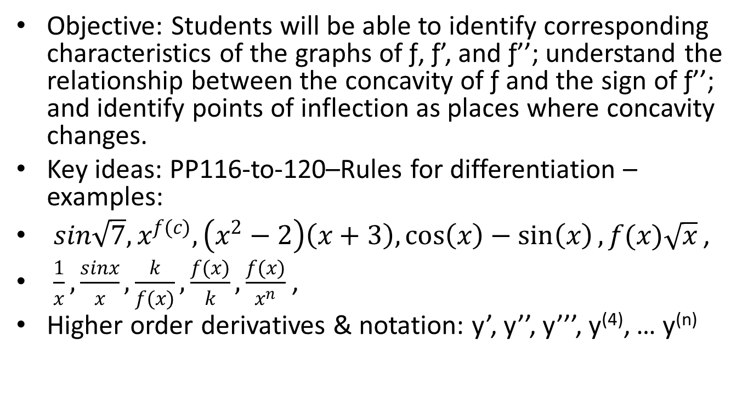
Second Derivatives [Unit 3.3]
Objective: Students will be able to identify corresponding characteristics of the graphs of ƒ, ƒ’, and ƒ’’; understand the relationship between the concavity of ƒ and the sign of ƒ’’; and identify points of inflection as places where concavity changes.
Key ideas: PP116-to-120–Rules for differentiation – examples:
$sin\sqrt{7}, x^{f(c)}, \left(x^{2}−2\right)\left(x+3\right),\cos\left(x\right)−\sin\left(x\right), f(x)\sqrt{x}$ ,
$\frac{1}{x}, \frac{sinx}{x}, \frac{k}{f(x)}, \frac{f(x)}{k}, \frac{f(x)}{x^{n}}$ ,
Higher order derivatives & notation: y’, y’’, y’’’, y⁽⁴⁾, … y^{(n)}

Slide 11
Velocity and Rate of Change [Unit 3.4]
Objective: The student will understand the fundament relationships between position, velocity, speed, acceleration, and jerk.
Key ideas: P127–Instantaneous rate of change, P129–definition of speed, “Sensitivity” to change.

Slide 12
Derivatives of Trig Functions [Unit 3.5]
Objective: The student will master derivatives of basic trigonometric functions.
Key ideas: Understanding of the patterns relating the derivatives of the trig functions.

Slide 13
Derivatives of a Composite Function [Unit 3.6]
Objective: The student will master derivatives of composite functions through the application of the chain rule.
Key ideas: “Bar in sun” heat expansion example, P149–Chain rule; P151–Parametric application; Multiplication of related rates.

Slide 14
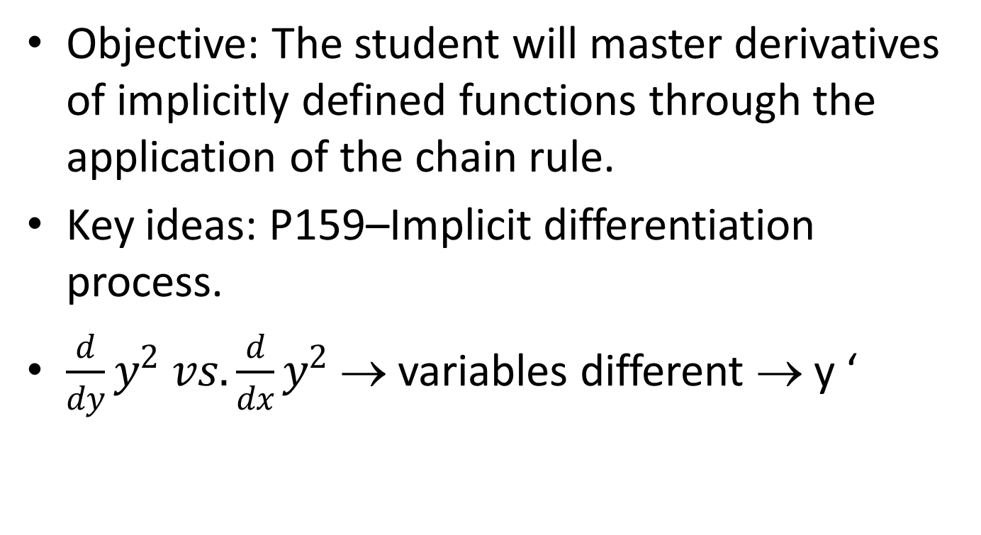
Implicit differentiation [Unit 3.7]
Objective: The student will master derivatives of implicitly defined functions through the application of the chain rule.
Key ideas: P159–Implicit differentiation process.
$\frac{d}{dy}y^{2} vs. \frac{d}{dx}y^{2}$ → variables different → y ‘

Slide 15
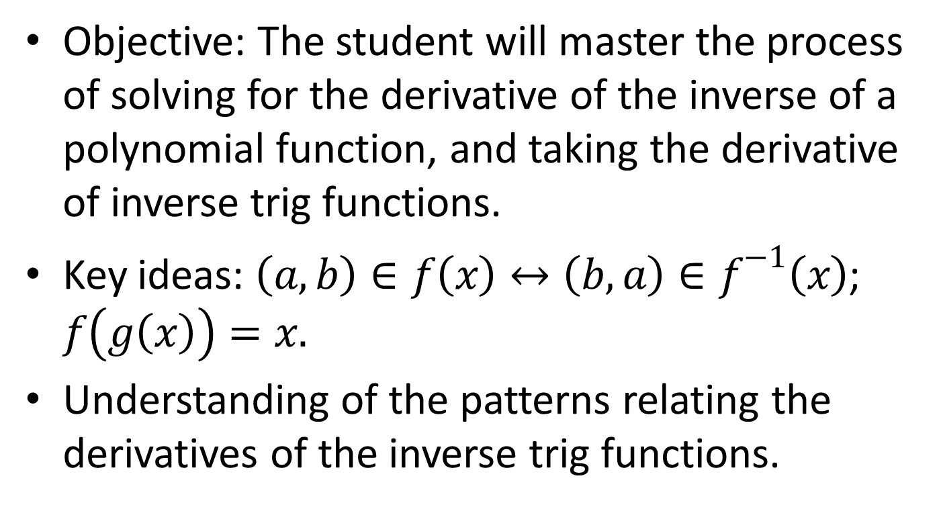
Derivatives of Inverse Functions
[Unit 3.8]
Objective: The student will master the process of solving for the derivative of the inverse of a polynomial function, and taking the derivative of inverse trig functions.
Key ideas: $\left(a,b\right)∈f\left(x\right)↔\left(b,a\right)∈f^{−1}\left(x\right)$; $f\left(g\left(x\right)\right)=x.$
Understanding of the patterns relating the derivatives of the inverse trig functions.

Slide 16
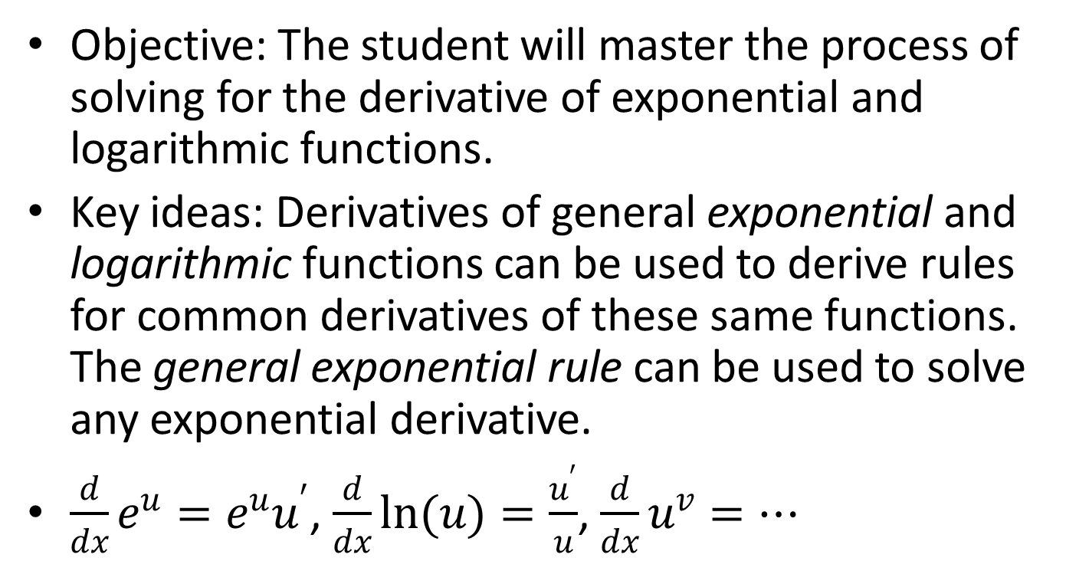
Derivatives of Exponential and Logarithmic Functions [Unit 3.9]
Objective: The student will master the process of solving for the derivative of exponential and logarithmic functions.
Key ideas: Derivatives of general exponential and logarithmic functions can be used to derive rules for common derivatives of these same functions. The general exponential rule can be used to solve any exponential derivative.
$\frac{d}{dx}e^{u}=e^{u}u^{′}$, $\frac{d}{dx}ln(u)=\frac{u^{′}}{u}$, $\frac{d}{dx}u^{v}=…$

Slide 17
Extreme Values of functions [Unit 4.1]
Objective: The student will be able to draw conclusions from derivatives about the extreme values of functions and the general shape of the function’s graph.
Key ideas: P187–Absolute extreme values; P188–EVT; P189–Local extreme values; P190–Critical points; Canditate Test for Abs Max/Min.

Slide 18
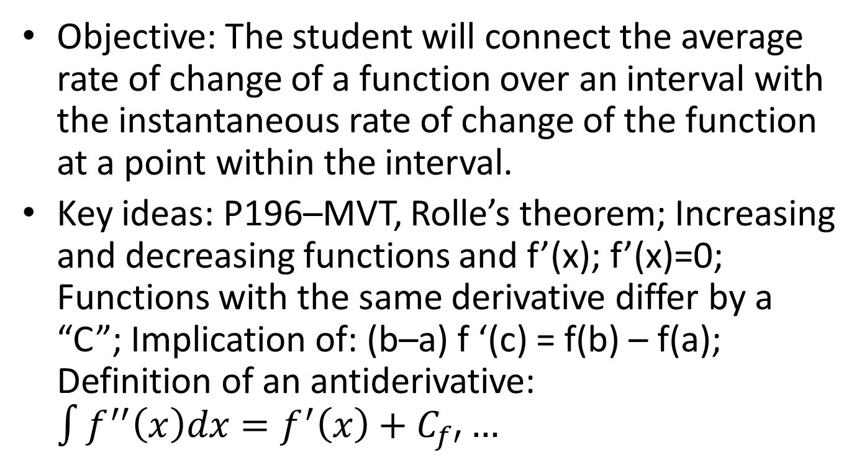
Mean Value Theorem [Unit 4.2]
Objective: The student will connect the average rate of change of a function over an interval with the instantaneous rate of change of the function at a point within the interval.
Key ideas: P196–MVT, Rolle’s theorem; Increasing and decreasing functions and f’(x); f’(x)=0; Functions with the same derivative differ by a “C”; Implication of: (b–a) f ‘(c) = f(b) – f(a); Definition of an antiderivative: $\int{f^{′′}\left(x\right)dx=f^{′}\left(x\right)+C_{f′}…}$

Slide 19
Connecting f, f ’ & f ’’ [Unit 4.3]
Objective: The student will master the construction of a mathematical model from the properties of a function’s derivatives.
Key ideas: P205–1st Derivative Test; P207–Concavity; P208–Points of inflection; P211–2nd Derivative Test; importance of words: “sign changed”.
f’’(x) slopes of f’(x) → f’’ gives max/min of f’

Slide 20
Modeling and Optimization [Unit 4.4 – Deferred in BC]
Objective: The student will be able to construct an optimized mathematical model of real-world application.
Key ideas: P219–Strategy for solving Min/Max problems; identifying “restricting” equation → reducing to 1 variable

Slide 21
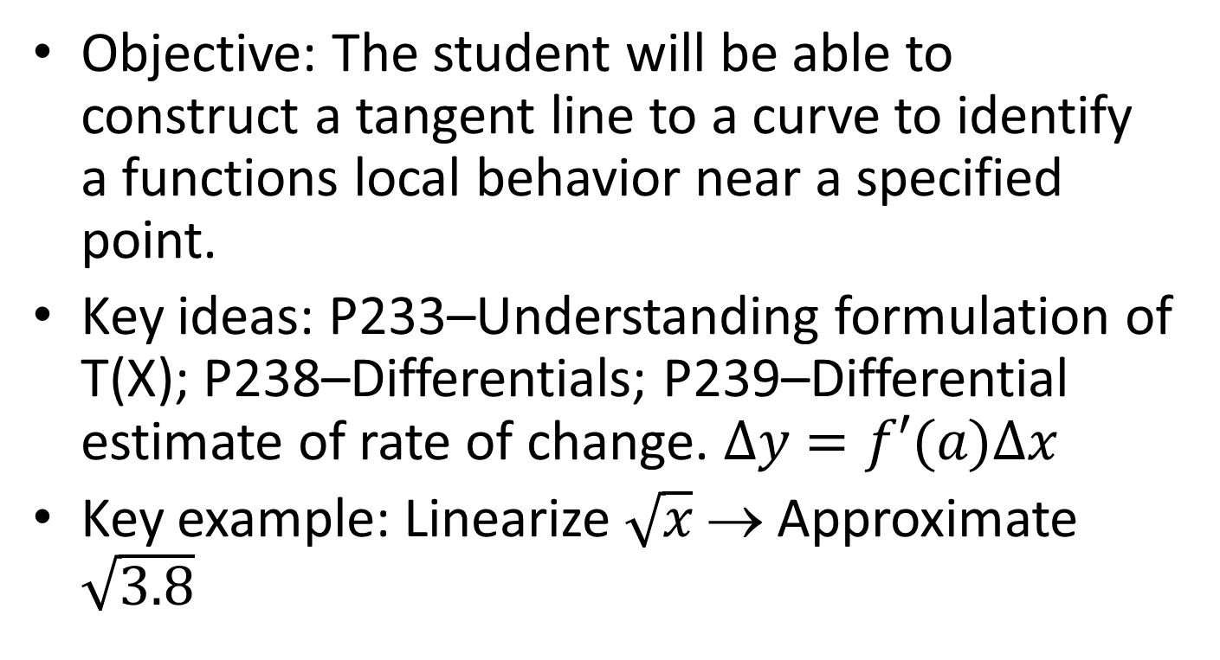
Linearization [Unit 4.5]
Objective: The student will be able to construct a tangent line to a curve to identify a functions local behavior near a specified point.
Key ideas: P233–Understanding formulation of T(X); P238–Differentials; P239–Differential estimate of rate of change. $∆y=f′(a)∆x$
Key example: Linearize $\sqrt{x}$ → Approximate $\sqrt{3.8}$

Slide 22
Related Rates [Unit 4.6]
Objective: The student will be able to construct and solve a differential equation involving 2 or more variables of differential functions of time; especially as related to problems in Newtonian mechanics.
Key ideas: Strategy for solving related rate problems → reducing to 1 variable; inserting constants after differentiation

Slide 23
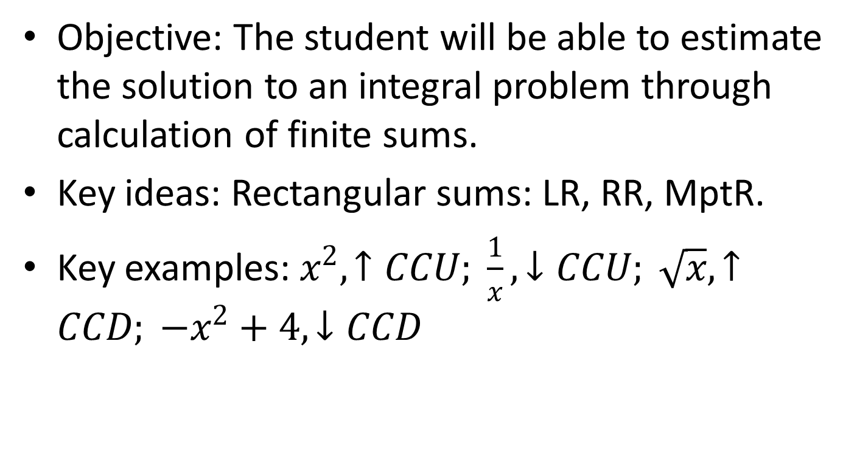
Estimating with Finite Sums [Unit 5.1]
Objective: The student will be able to estimate the solution to an integral problem through calculation of finite sums.
Key ideas: Rectangular sums: LR, RR, MptR.
Key examples: $x^{2}, ↑CCU; \frac{1}{x}, ↓CCU; \sqrt{x}, ↑CCD; −x^{2}+4, ↓CCD$

Slide 24
Definite Integrals [Unit 5.2]
Objective: The student will master the construction of an integral as a limit of a Reimann sum.
Key ideas: Reimann sums; component notation of definite integral; area under a curve; integral as a vector; integration of discontinuous functions; use of geometry

Slide 25
Definite Integrals and Antiderivatives [Unit 5.3]
Objective: The student will master the rules for definite integrals; the average value theorem; and MVT for definite integrals.
Key ideas: Finding the solution of an integral problem through the use of antiderivatives; properties → integrals are limits!; “F” antiderivative “f”. Integrals on the calculator

Slide 26
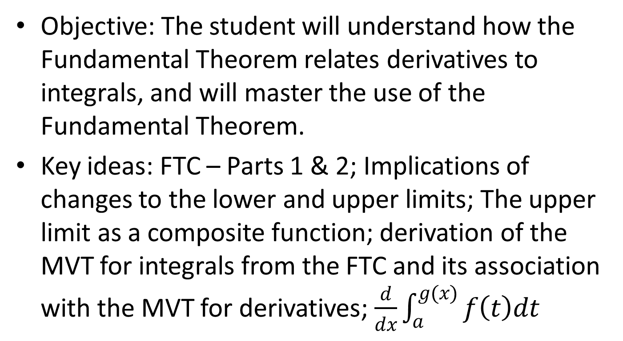
Fundamental Theorem of Calculus [Unit 5.4]
Objective: The student will understand how the Fundamental Theorem relates derivatives to integrals, and will master the use of the Fundamental Theorem.
Key ideas: FTC – Parts 1 & 2; Implications of changes to the lower and upper limits; The upper limit as a composite function; derivation of the MVT for integrals from the FTC and its association with the MVT for derivatives; $\frac{d}{dx}\int_{a}^{g(x)}{f\left(t\right)dt}$

Slide 27
Trapezoidal Rule [Unit 5.5]
Objective: The student will master the use of the Trapezoidal rule in approximating the solution of integral problems.
Key ideas: Trapezoidal rule as an average of left and right Reimann sums; intuitive understanding of effects of f ‘ and f ‘’ on answers to use of TR, LR, RR and the exact answer [I]

Slide 28
Slope Fields [AB&BC] & Euler’s Method [BC] [Unit 6.1]
Objective: The student will be able to approximate the solution to any differential equation of two variables graphically [slope fields] or numerically [Euler’s method.]
Key ideas: Use of visual approximations of rate-of-change to reconstruct a graphical solution to a differential equation [slope fields]; repeated use of tangent-line solution at a point [Euler’s method]

Slide 29
Techniques of Antidifferentiation [Unit 6.2]
Objective: The student will be able to find antiderivatives following directly from derivatives of basic functions; antiderivatives by substitution of variables (and change of limits for definite integrals); and antiderivatives by pattern matching.
Key ideas: Pattern matching is derived from the chain rule. Substitution reduces the complexity of the integrand; memorization of basic derivatives is required

Slide 30
Integration by Parts [BC] [Unit 6.3]
Objective: The student will be able to find antiderivatives for a product of two un-related functions.
Key ideas: IBPs is derived from the product rule for derivatives; “+uv” is the key to memorizing the tabular method – which requires “u” to be differentiable to “0”

Slide 31
Exponential Growth and Decay
[Unit 6.4]
Objective: The students will be able to solve separable differential equations and use them in modeling (including the study of exponential growth). The student will be able to find specific antiderivatives using initial conditions.
Key ideas: 1st step – separate the variables; population problems – find the initial population and growth constant K: K<0 → decay, K>0 → growth

Slide 32
Logistics Growth [BC] [Unit 6.5]
Objective: The students will be able to solve real-world logistics growth problems as functions of time and population.
Key ideas: Integration by partial fractions; carrying capacity limit growth of population, initial population possibilities; population at maximum rate of growth, time of maximum rate of growth; ratio of (M-P₀)/P₀

Slide 33
Integral as net change [Unit 7.1]
Objective: The students will be able to model real-world problems, and convert the model into an integral.
Key ideas: Approximating with a Reimann sum

Slide 34
Areas in the Plane [Unit 7.2]
Objective: The students will be able to model real-world, planar-representation problems, and explain and interpret the solution using proper units.
Key ideas: Upper-function – Lower-function; Right-function – Left-function; integrating in “y” vs. “x”; use of symmetry to simplify problems; use of geometry when possible

Slide 35
Volumes [Unit 7.3]
Objective: The students will be able to solve for the volume of a 3D object which as a known cross section.
Key ideas: Volumes of revolution – x&y axes, lines || to x&y axes; cylindrical shell technique; volumes with algebraically-defined cross sections

Slide 36
Lengths of Curves [BC] [Unit 7.4]
Objective: The students will be able to find the length of a smooth curve using along the x, y or t axes.
Key ideas: Pythagorean form of the differential line segment.

Slide 37
Science and Statistics Applications [AB] [Unit 7.5]
Objective: The student will be able to explain a diversity of ways in which integrals can be used to solve real-world applications.
Key ideas: Using the units defined to determine the correct approach to a solution

Slide 38
L’Hopital’s Rule [BC] [Unit 8.2]
Objective: The student will be able to recognize the 7 indeterminate forms of limits, and apply appropriate algebraic techniques to allow for the use of L’Hopital’s solution.
Key ideas: Definition of “convergence”; infinite sequences

Slide 39
Relative Rates of Growth
[BC] [Unit 8.3]
Objective: The student will be able to understand growth rates as a key aspect of modeling long-term behavior of functions.
Key ideas: Parent function end-behavior

Slide 40
Improper Integrals [BC] [Unit 8.4]
Objective: The student will be able to evaluate integrals in which an infinity is involved in the specification of the domain function.
Key ideas: Converting infinities to limits at infinity; “removing” negative exponents, “spliting” domains; using L’Hopital’s rule; recognizing vertical asymptotes in domain; solution by comparison with a known convergent or divergent function

Slide 41
Power Series [BC] [Unit 9.1]
Objective: The student will be able to analyze a power series fro convergence, and perform term-by-term differentiation and integration of a power series.
Key ideas: representing functions as geometric series; exploration 1 – finding power series

Slide 42
Taylor Series [BC] [Unit 9.2]
Objective: The student will be able to generate a Taylor series from the definition; find a partial sum of a Taylor series; and identify special forms of the Taylor series for common applications.
Key ideas: Maclaurin → Taylor at “0”; “order” of a Taylor series; more terms → more accuracy; Taylor series for polynomials; combining Taylor series

Slide 43
Taylor’s Theorem [BC] [Unit 9.3]
Objective: The student will be able to evaluate the accuracy of a Taylor polynomial for a given number of terms.
Key ideas: Remainder is 1st unused term at unknown “c” → related to MVT

Slide 44
Radius of Convergence [BC] [Unit 9.4]
Objective: The student will be able to find the radius of convergence of an arbitrary power series.
Key ideas: Nth-term test; direct comparison test; absolute convergence; ratio test; sum of a telescoping series

Slide 45
Testing Convergence at End Points [BC] [Unit 9.5]
Objective: The student will be able to evaluate convergence at end points of a domain to determine the interval of convergence of an infinite series.
Key ideas: Integral test; p-series test; limit comparison test; alternating series test and error analysis; harmonic series; which to use? → rules-of-thumb

Slide 46
Parametric Functions [BC] [Unit 10.1]
Objective: The student will be able to apply the theorems of calculus to functions described in parametric form.
Key ideas: Chain rule; Pythagorean form of differential arc length

Slide 47
Vectors in the Plane [BC] [Unit 10.2]
Objective: The student will be able to apply the theorems of calculus to functions described in vector form.
Key ideas: Applying theorems to vector components; displacement vs. distance traveled

Slide 48
Polar Functions [BC] [Unit 10.3]
Objective: The student will be able to apply the theorems of calculus to functions described in polar form.
Key ideas: Polar a form of parametric; “looping” requires analysis of domain; to find values at pole set r=0; area calculated by sweeping out triangles. [Note: length of polar curves not in curriculum]

